Slide 1
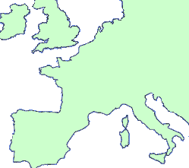
Colonial Controls Takes Many Forms
1) Colony -area ruled by a foreign government (“Country or territory
governed internally by a foreign power”)
(2) Protectorate -runs its own daily affairs, but is controlled by an imperialist nation (“Own internal government, but under control of an outside power”)

Slide 2
Colonial Controls Takes Many Forms
(3) Sphere of Influence an area where an imperialist nation has exclusive economic rights (“Outside power has investment or trading privileges”)
(4) Economic Imperialism- independent nation controlled by foreign business rather than foreign governments (“Independent/less-developed country controlled by business interests and not government”

